Slide 1
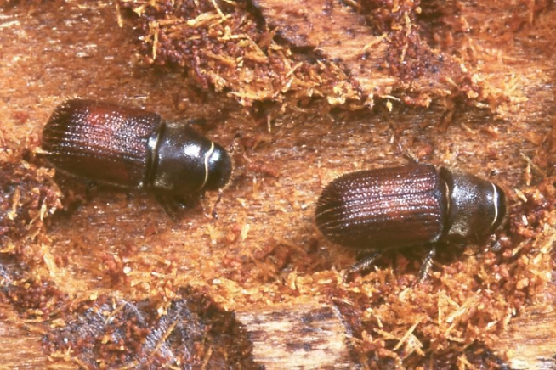
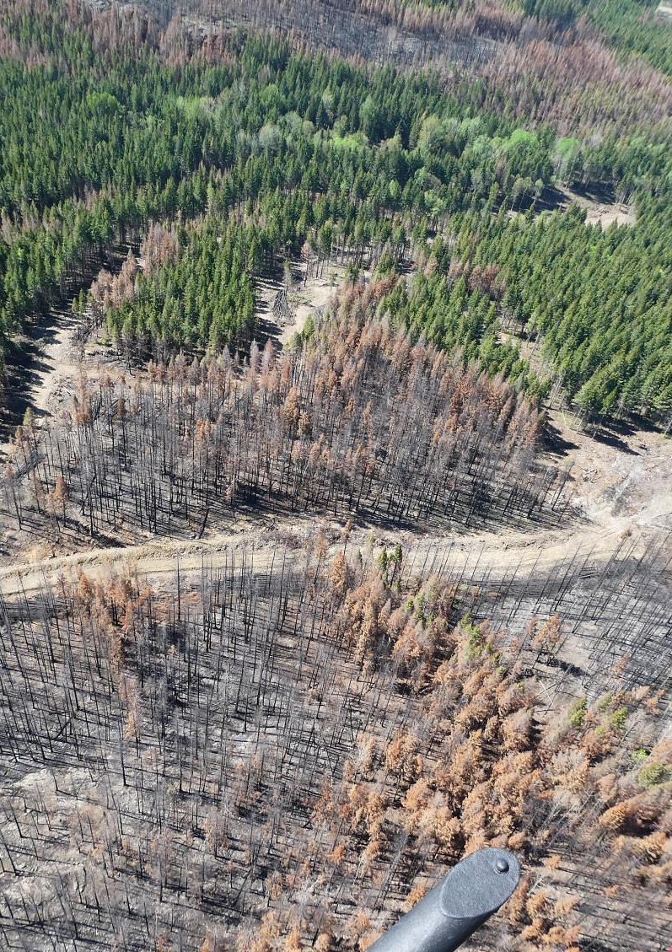
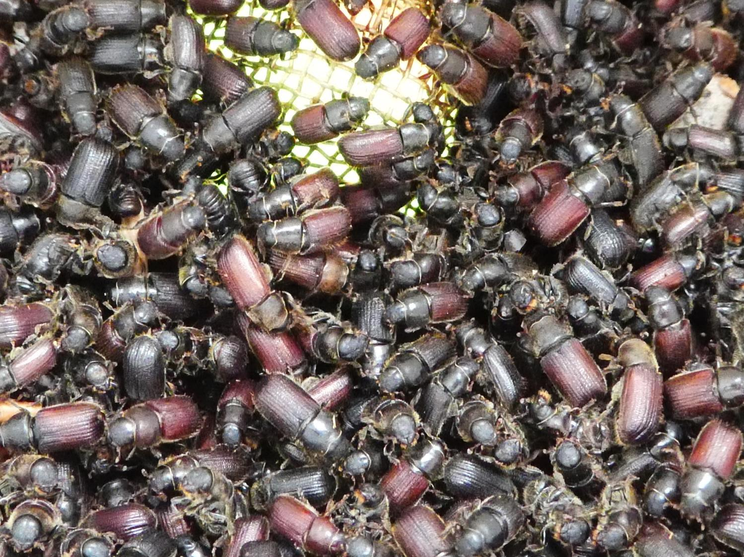


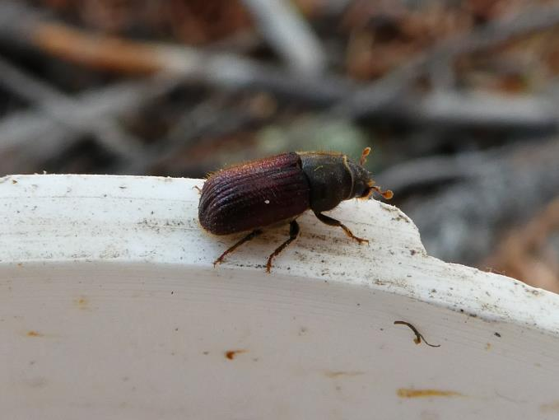
Managing Douglas-fir Beetle in a Post-wildfire Environment
Lorraine Maclauchlan
Forest Entomologist

Slide 2
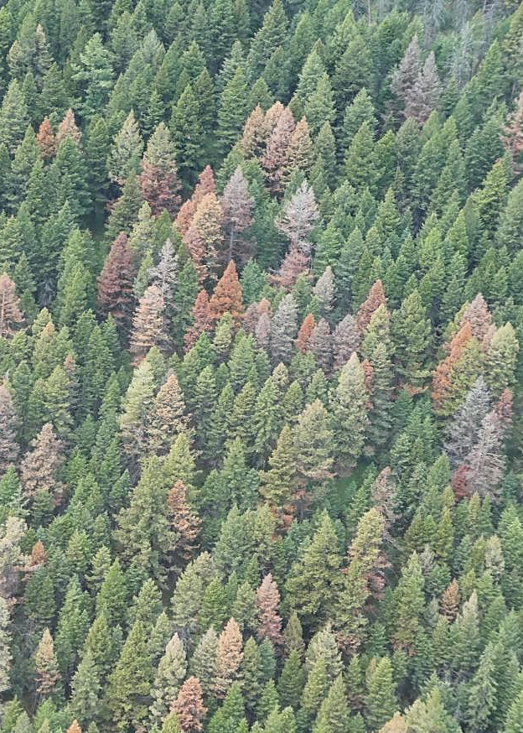
Managing Douglas-fir Beetle in a Post-wildfire Environment
Life History & Current Status
Detection
hazard & risk rating
aerial
ground
Management Options
targeted harvest using semiochemicals
Critical Dates

Slide 3
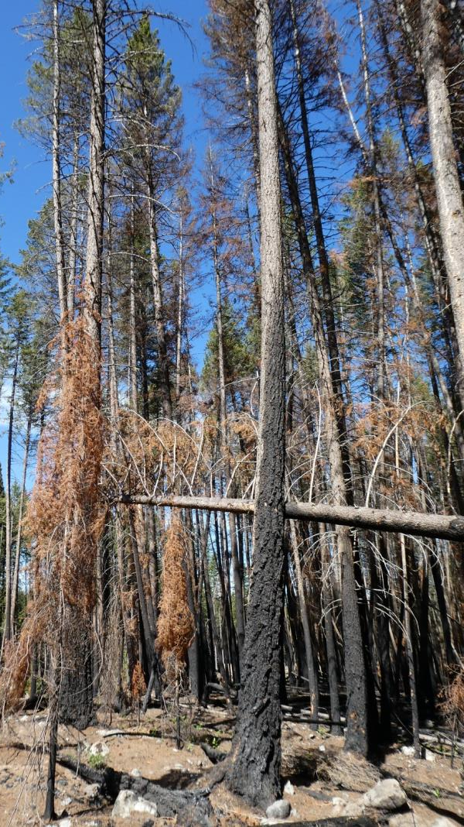
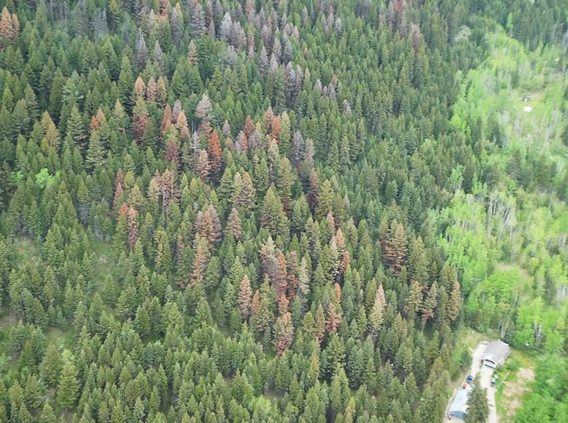
Host preference
Life History
large, old Douglas-fir (>30cm)
fire-scarred fir
fresh wind throw or felled fir
stressed, diseased . . .
Notes:
Prewfers freshly felled or windthrown trees
It will kill standing trees which is similar to the behaviour of the spruce beetle
IBM only attacks standing trees.

Slide 4
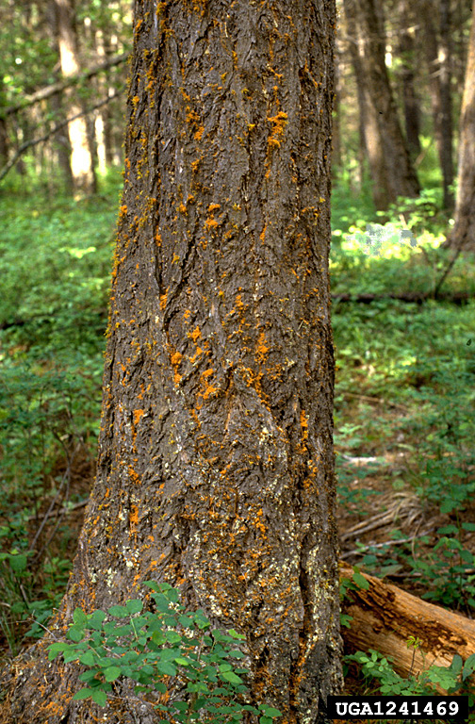
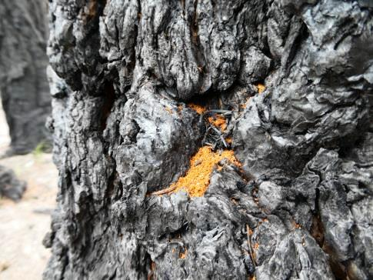
Bole symptoms:
The first sign of DFB attack is orange-brown frass and sawdust in bark crevices and around base of tree.
Attack is visible from April-June to early fall (after this time frass fades & gets washed away).

Slide 5
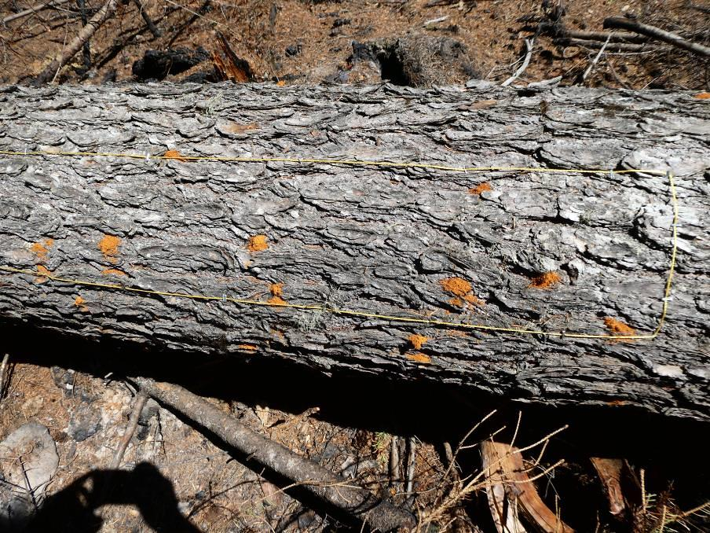
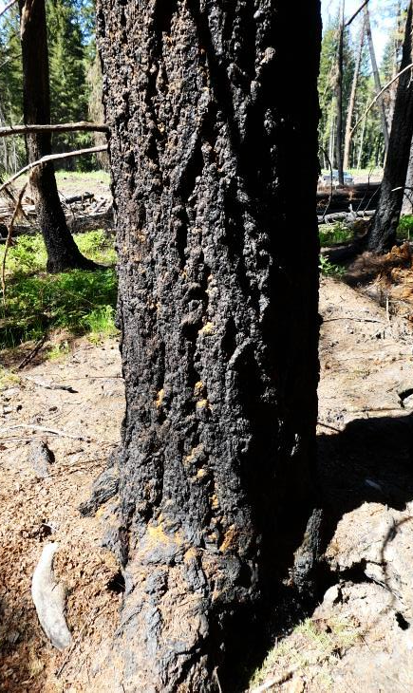
Primary attraction: DFB is attracted by host oleoresin - alpha-pinene, camphene, and limonene
Host attraction precedes the beetle attraction which is produced by unmated females shortly after entering the host and which results in mass concentration of beetles around the center of attraction.
Mass attack on fire scarred fir
Mass attack on felled trap tree
Notes:
DFB is attracted by oleoresin, particularly its alpha-pinene, camphene, and limonene fractions. In the absence of such material the pioneer beetle dispersal appears to be rather uniform throughout the stand. This host attraction precedes the beetle attraction which is produced by unmated females shortly after entering the host and which results in mass concentration of beetles around the center of attraction.

Slide 6
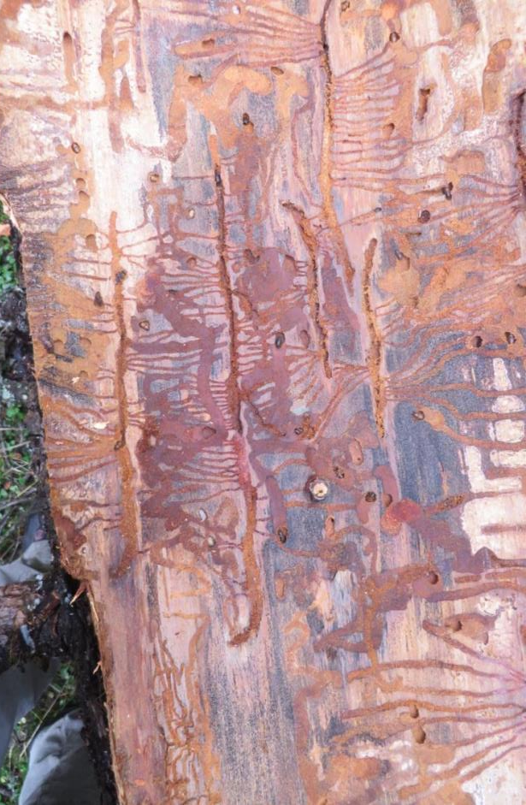
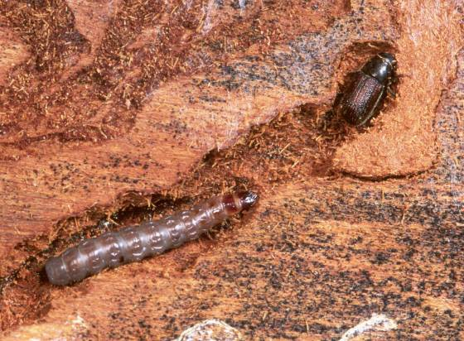
DFB beetle gallery
Under the bark:
Bottom hook on gallery
20 - 25 cm long parent gallery
Alternate, fan-shaped larval mines
Galleries packed with boring dust
Clerid beetle = predator

Slide 7
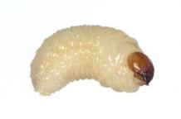
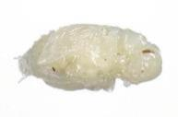
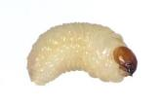

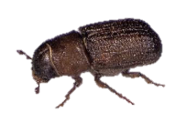



Larvae-pupae
June – July
Minor flight
2nd
Larvae-pupae-adults
Aug - Sept
Adults & larvae can overwinter
May - June
Peak flight
1st
Eggs-larvae
Main Flight
DFB Flight period
Complete Flight Period
March
April
May
June
July
August
Oct – Mar
Overwintering Period

Slide 8
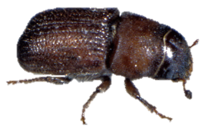
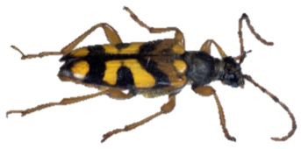
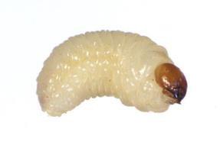
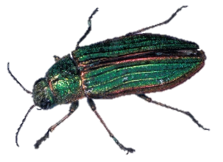
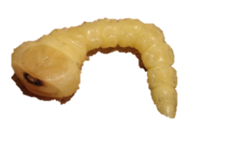
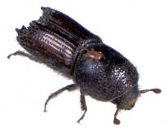
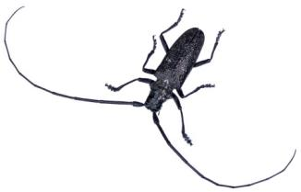
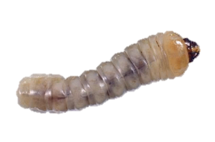
Key insects attacking fire-stressed trees:
Bark beetles, woodborers, ambrosia beetles, wood wasps, ants and others.
Each type of insect has its unique “signature”.
Bark beetles
Secondary bark beetles
Decomposers (woodborer, ambrosia beetle, wood wasp, ants)

Slide 9
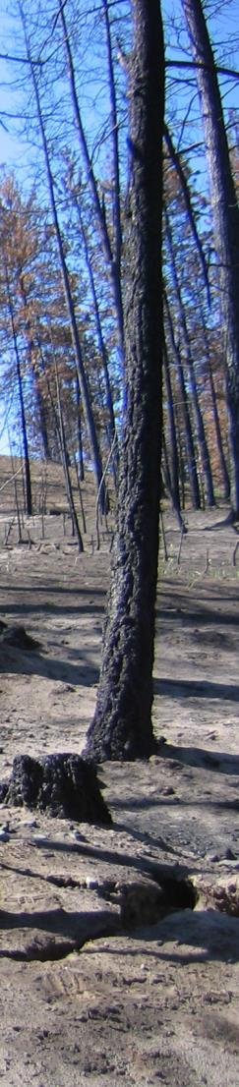
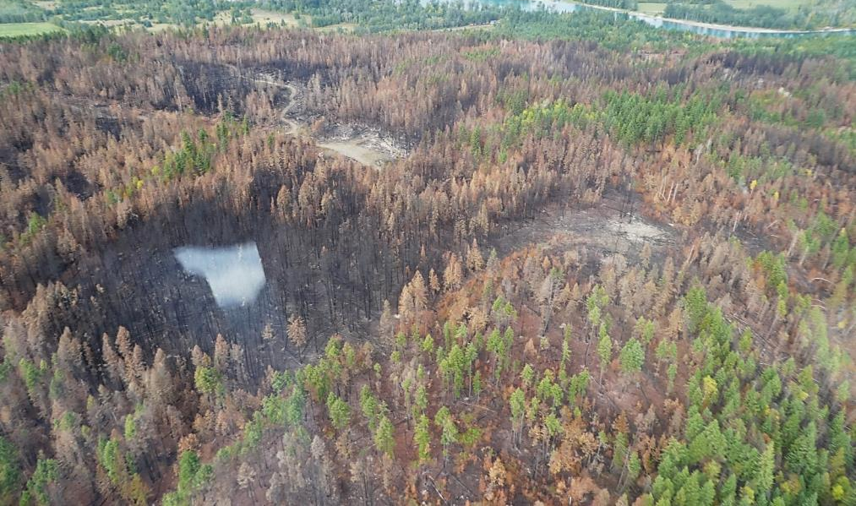
Douglas-fir post-fire mortality is confounded by Douglas-fir beetle attack.
Large trees that could survive fire-scorch are often attacked and killed by DFB.
Douglas-fir beetle seeks out the largest, burnt or semi-burnt trees within fire perimeter.

Slide 10
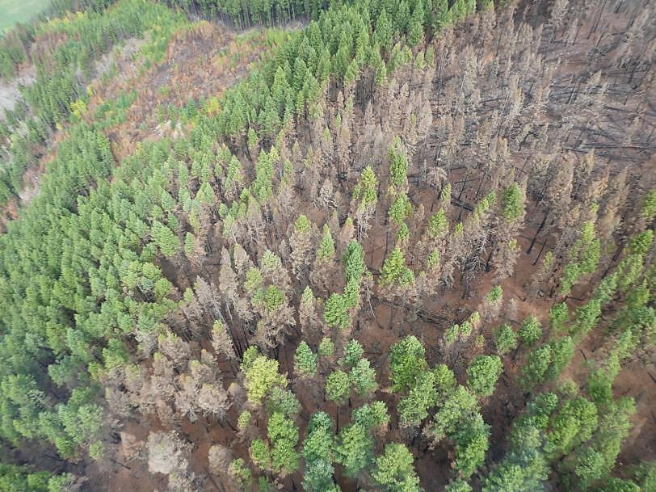
High quantities of host oleoresin (alpha-pinene, camphene, and limonene) is released from fire scorched trees.
Scorched trees have minimal resistance to DFB

Slide 11
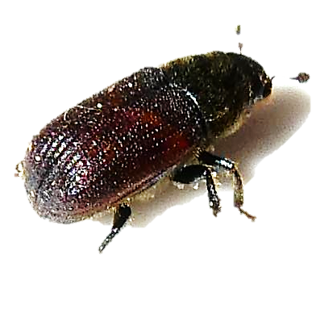
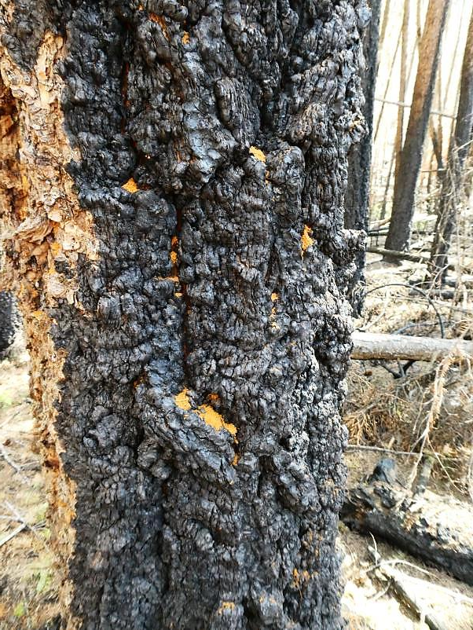
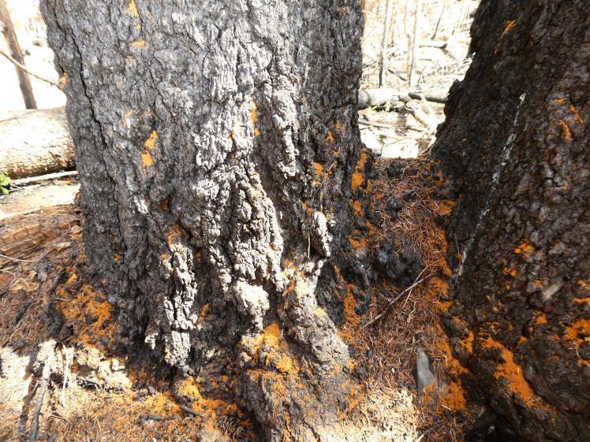
Current Status
Douglas-fir beetle is flying!

Slide 12
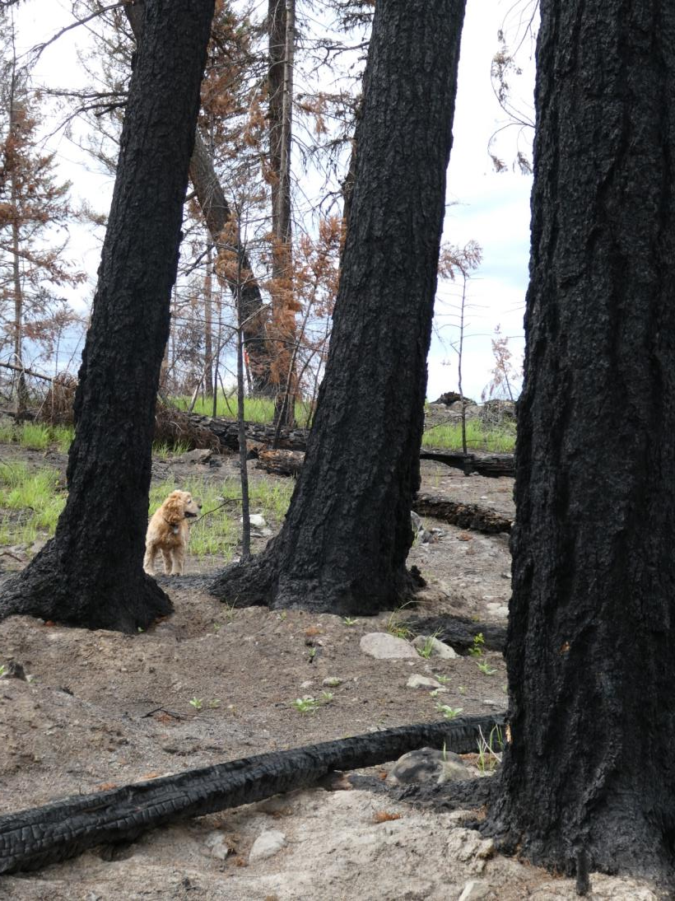
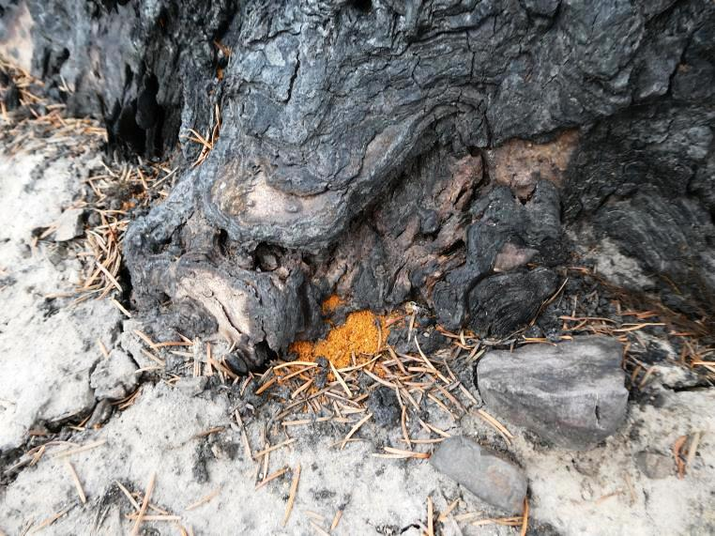
Large burnt Douglas-fir on Deadman side of Elephant Hill fire attacked by Douglas-fir beetle.

Slide 13
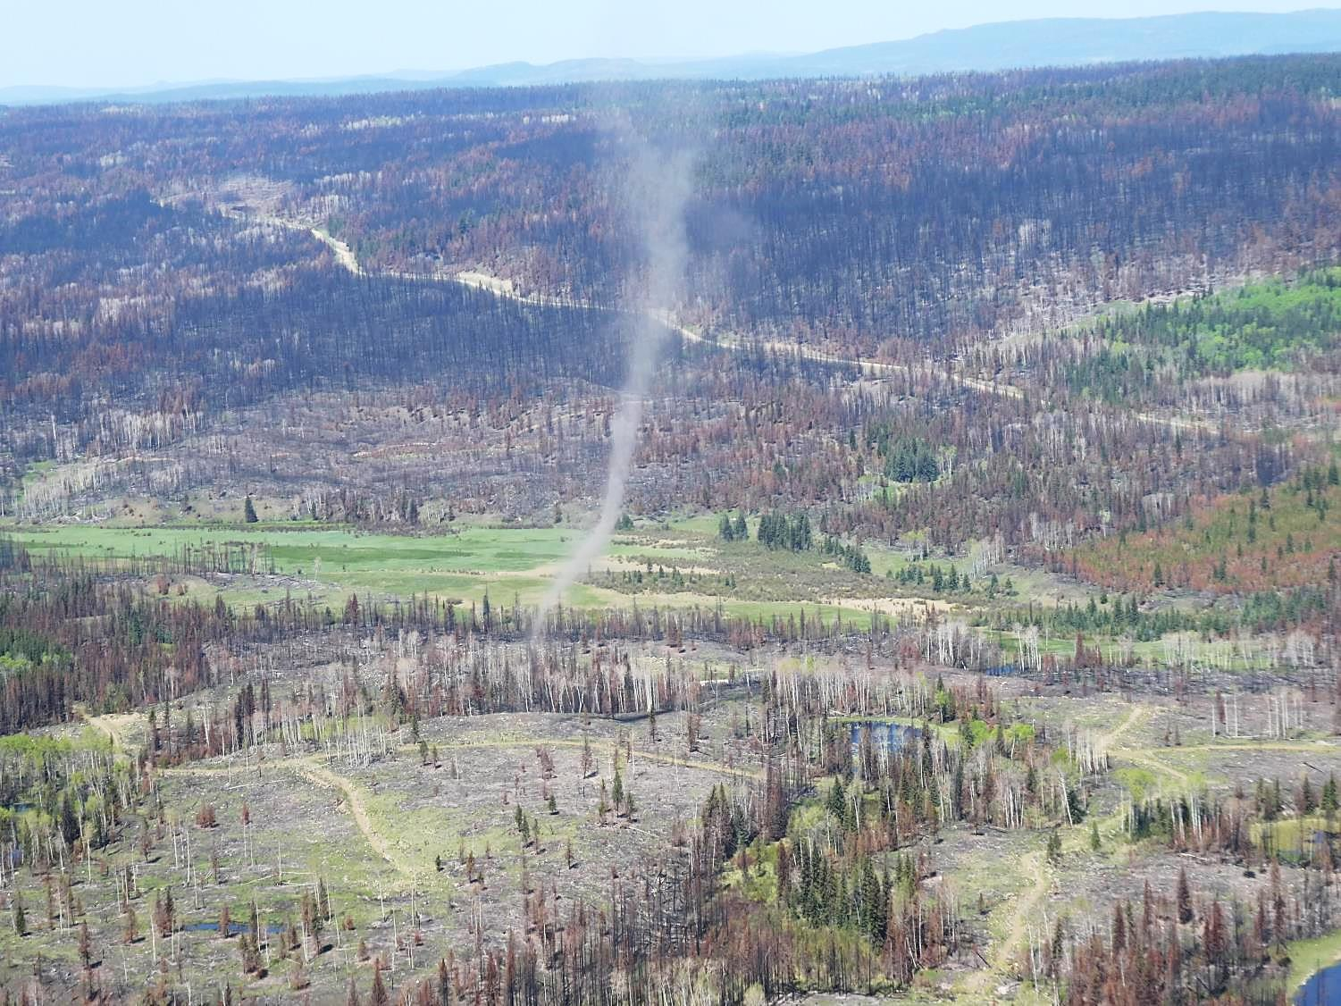
Detection
Wild Fires create an abundance of highly susceptible & attractive host material for DFB.
Notes:
Fires creates an abundance of highly susceptible & attractive host material for insects.
2017 was another year of large wildfires & widespread drought.
Insects will be Part 2 of this disturbance event – so we must anticipate, plan accordingly and react quickly.

Slide 14
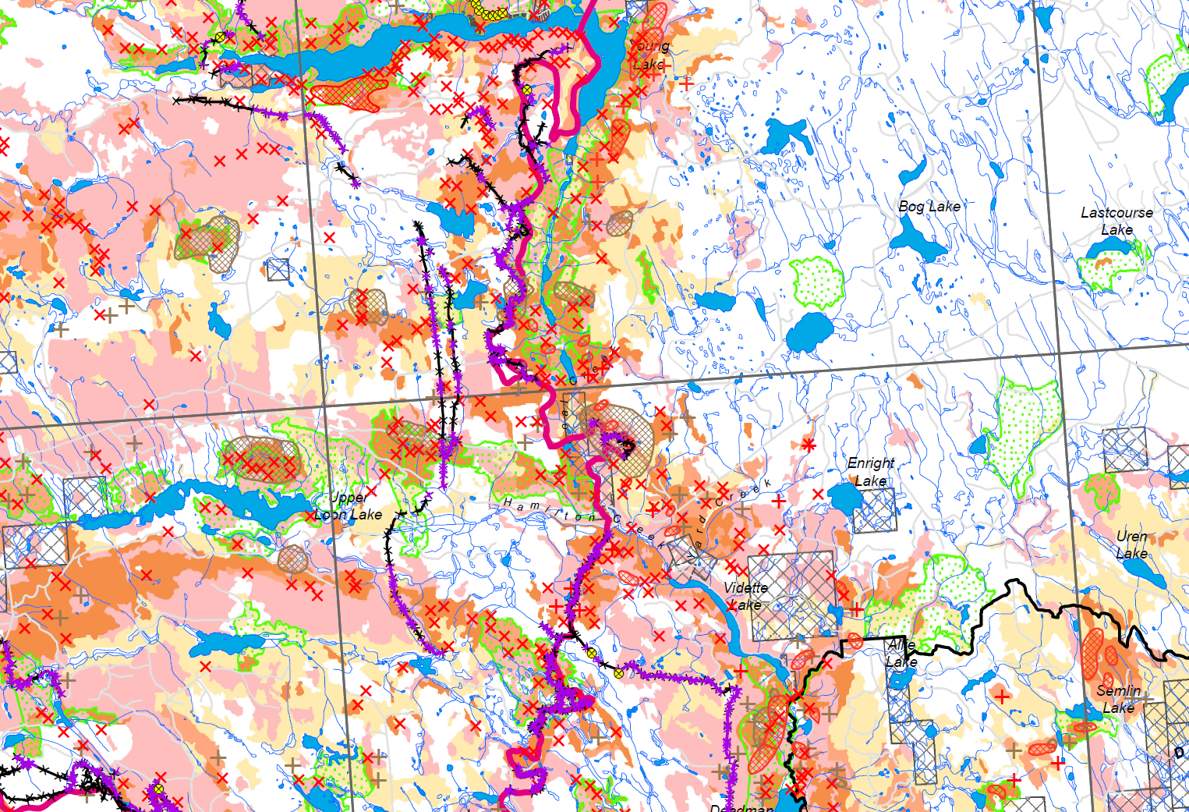
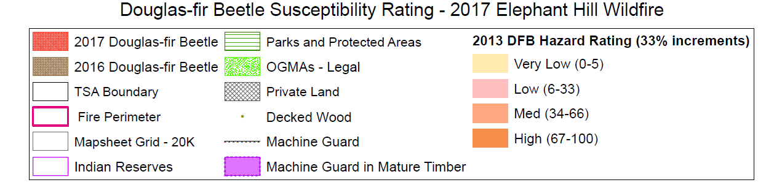

Slide 15
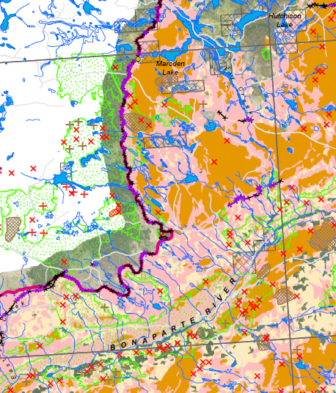
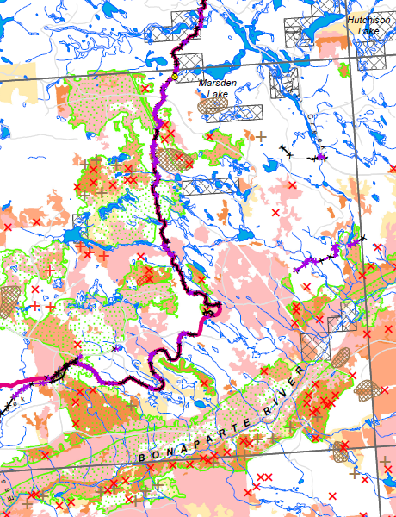
Fire Severity & DFB mapping (2017, 2016)
DFB Hazard & beetle mapping (2017, 2016)

Slide 16
Detection
Hazard and risk rating
Identify High Hazard and High Risk areas inside fire perimeter and on edges
Identify burn severity and assign risk for further mortality (fire & DFB)
Identify closest and largest conflagrations of DFB attack (mapped 2018 reds) and ground surveyed 2018 green attack
Plan harvest based on “values-at-risk”
Harvest should maximize beetle removal, burnt wood salvage, restoration.

Slide 17
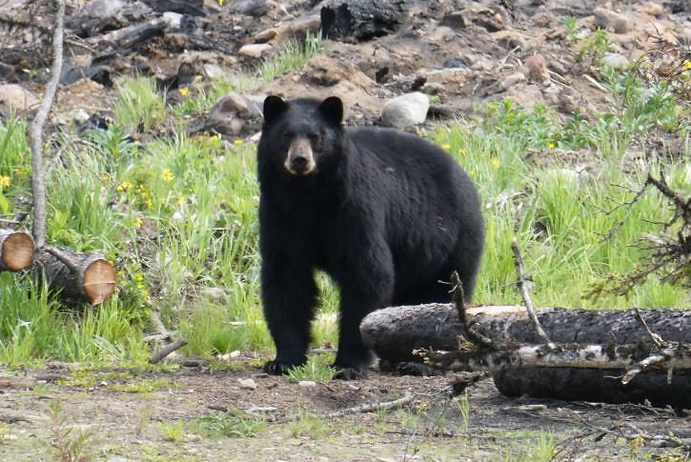
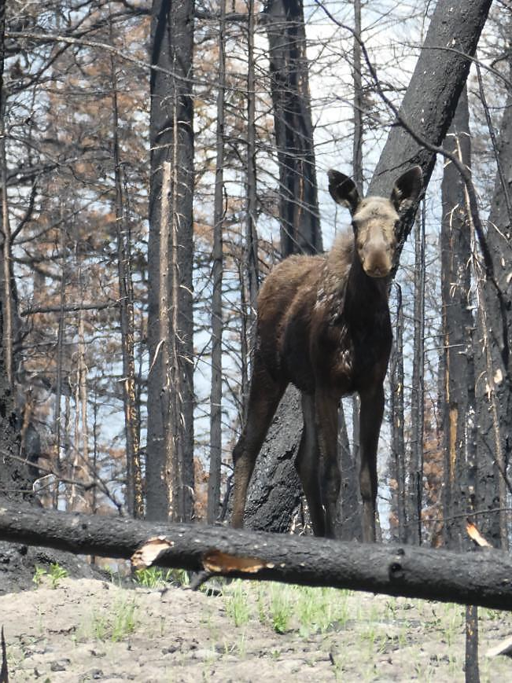
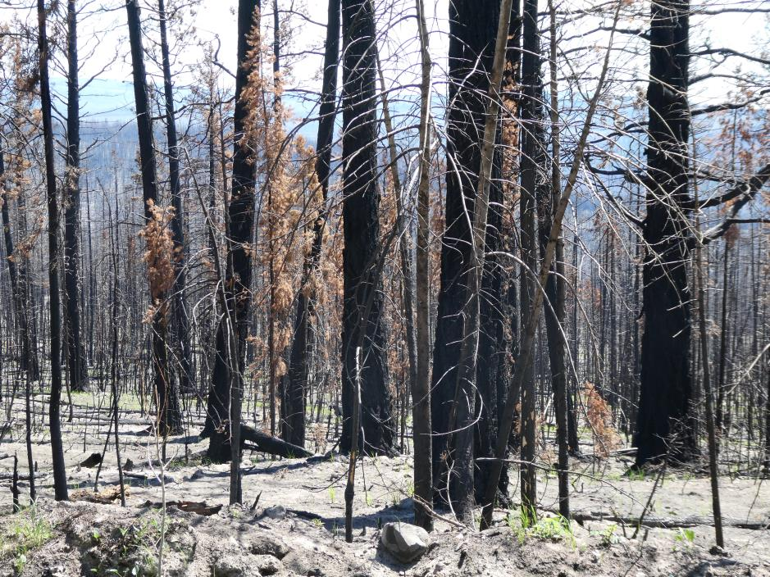
Values at Risk

Slide 18
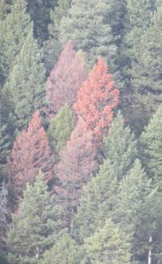
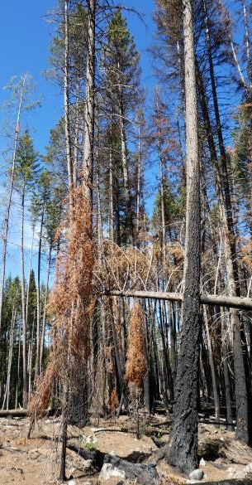
RISK 2018 (high to low):
Proximity to 2017 mapped red attack
Blackened, large, thick bark fir
Red crown, large-medium size fir
Partial scorched, crown large-medium size fir
RISK 2019-20 (high to low):
Proximity to 2018 green attack
Live fir within fire perimeter (large, old) and live fir outside, on edge of fire

Slide 19
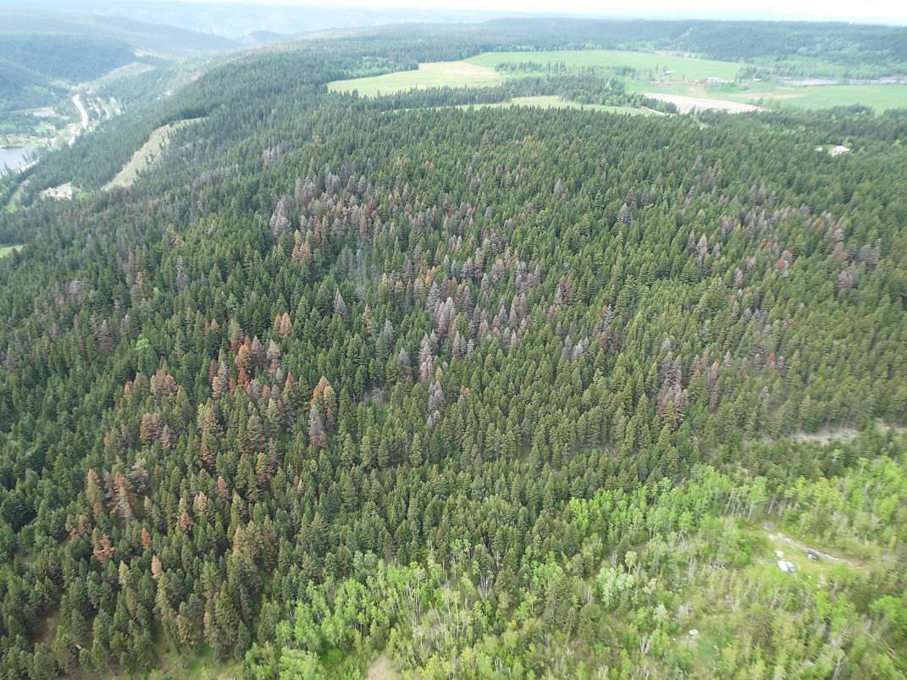
Detection
Aerial

Slide 20
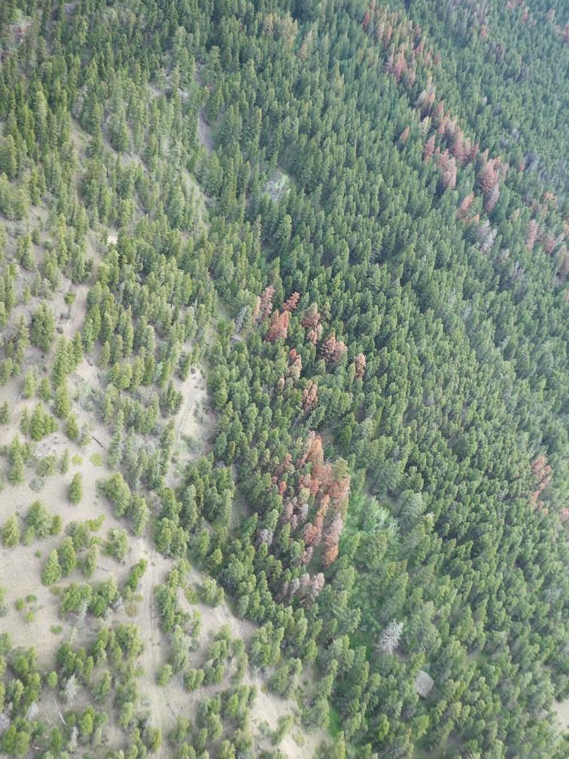
Detailed aerial surveys:
Start as soon as the majority of trees have faded
DFB is spatially discrete - patches (>10 trees) or spots (1-10 trees)
Attacked trees (2017 attack) are chlorotic to a pinky-red
Dark red or grey are usually old attacks (contain no DFB) and NOT MAPPED
20-25 reds
20 reds
spot

Slide 21
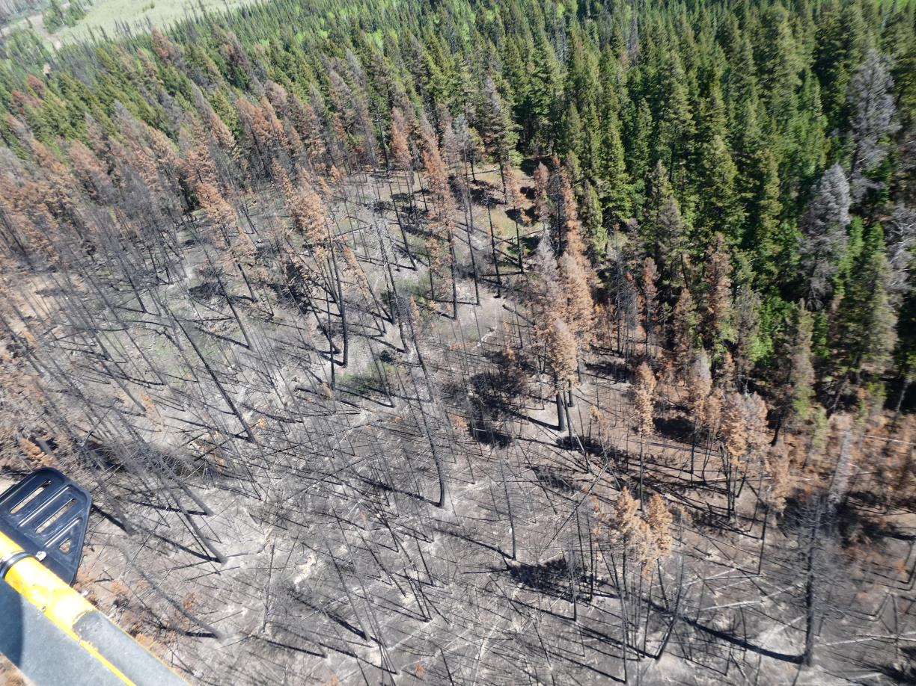
Scorched crowns and DFB hard to differentiate from the air.
Fly and map only outer perimeter of fires.
Notes:
Fires creates an abundance of highly susceptible & attractive host material for insects.
2017 was another year of large wildfires & widespread drought.
Insects will be Part 2 of this disturbance event – so we must anticipate, plan accordingly and react quickly.

Slide 22
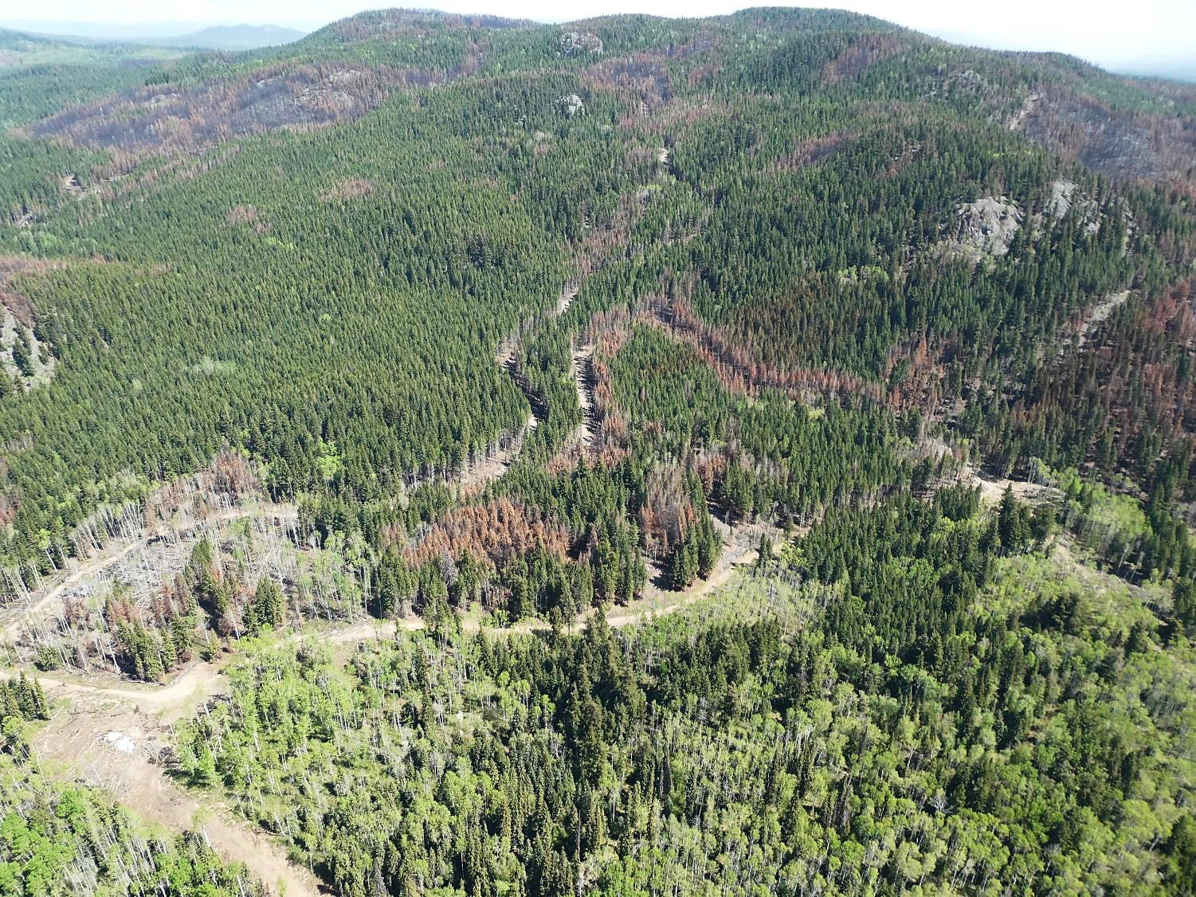

Slide 23
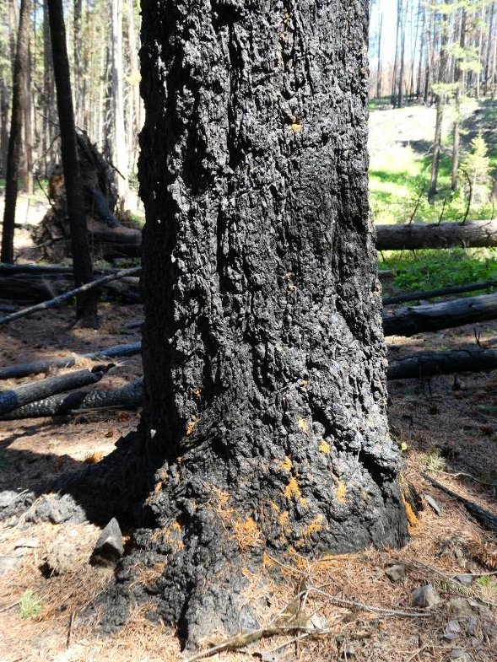
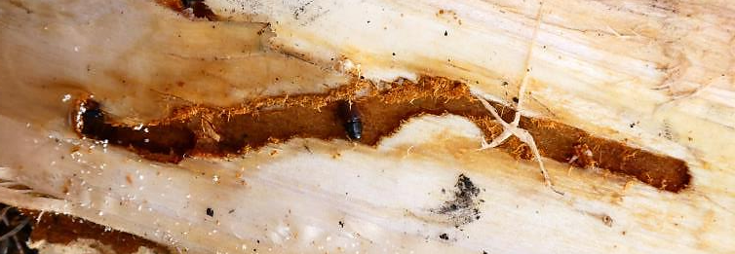
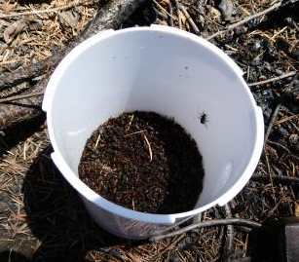
Detection
Ground
Ground survey in stands identified as High Hazard and Risk inside fire perimeter
Prioritize ground surveys by Fire Severity
(it is now to late to influence where DFB will attack this year)

Slide 24

Distance of new attack from previous year attack centers:
  Unpredictable, 50m to 200m away from brood trees
  reduced dispersal may occur as population vigor declines

Slide 25


Check all fire guards (cut trees) for DFB attack – prioritize for removal

Slide 26
Management Options
  Do Nothing – OGMAs, other constrained areas
  Clearly delineate where aggressive management/harvest will occur
  Harvest 2018 green attack before 2019 flight but always plan for two years of beetle management/extraction
  Use appropriate tools to maximize DFB extraction with fibre extraction (for next spring)
  tree baiting (grid or spot)
  funnel/mass trapping DFB within stands to promote overflow attack and in severe burn areas to augment harvesting
  conventional (green) trap trees – in 2019-2010 when DFB moves out of fire perimeter into green fir

Slide 27

Management Options
targeted harvesting using semiochemicals
Funnel traps (groups) placed in burned areas will capture DFB throughout flight period and promote overflow attack on surrounding Fd.
Maximizes beetle capture and extraction.

Slide 28

Scorched trees are attractive host for DFB so use conventional trap trees (TT) on/outside burn perimeter (green trees)
  1 TT for every 4-10 infested trees
  largest available green fir
  shaded, not limbed or bucked
  can saturate in 20-30 days
  will create spillover
  attract both ♀ + ♂
** trap trees effective near fire setting but use burnt trees as “beetle sinks” where ever possible

Slide 29



Use in-block tree baiting to hold beetles in proposed blocks and to attract DFB populations that are adjacent or dispersing
beetles may not utilize full tree
attack is spread over more trees (less attack/tree)
Optimize use of mass trapping techniques in very severely burned areas, clearings - near active DFB populations

Slide 30


MCH – can protect live, green fir from DFB in special or constrained areas.
OGMA
MCH pouch

Slide 31

Critical Dates
  Detailed aerial surveys – June through early July
  Aerial Overview Survey (Provincial, high level survey) – mid-July through August
  Ground detection – August (July) to November (optimum) but can continue through winter
  Delineate harvest blocks (fall-winter)
  Harvest 2018 DFB attack prior to April 2019 or implement a holding strategy (baits, funnel traps, trap trees) for 2019 DFB flight and harvest

Slide 32


Thank you.

